Slide 1



Slide 2

XPATH
Khanh Le
CoE
Version 1.0

Slide 3

Agenda
Introduction
Basic Level
Advance Level
SUMMARY
QA
XPATH
XPath Nodes
Relationship
Syntax
Absolute/ Relative Path
Axes
Operators
Functions
Useful expression

Slide 4
Introduction

Slide 5
What is XPATH?
XPath is a major element in W3C's XSLT standard - and XQuery and XPointer are both built on XPath expressions.
XPath is a query language used to traverse through an XML document.
It is used commonly to search particular elements or attribute with matching patterns.

Slide 6
Basic Level

Slide 7
XPATH NODES
XPath expression generally defines a pattern in order to select a set of nodes.
7 types:
Root Node.
Element Nodes
Text Nodes
Attribute Nodes
Comment Nodes
Processing Instruction Nodes
Namespace Nodes

Slide 8
XPATH NODES
Root Node:
XML documents are treated as trees of nodes. The topmost element of the tree is called the root element.
The element node for the document element is a child of the root node.
<?xml version="1.0" encoding="UTF-8"?> <training> <room> <title lang="en">Old Trafford</title> <table>25</table> <computer>5</computer> </room> </ training>
=> <training> is root element node.

Slide 9
XPATH NODES
Element Nodes :
The children of an element node are the element nodes, comment nodes, processing instruction nodes and text nodes for its content.
An element node may have a unique identifier (ID)
No two elements in a document may have the same unique ID
<?xml version="1.0" encoding="UTF-8"?> <training> <room> <title lang="en">Old Trafford</title> <table>25</table> <computer>5</computer> </room> </ training>
=> <room>, <title> , <table>, <computer> are element nodes.

Slide 10
XPATH NODES
Text Nodes:
A text node always has at least one character of data.
Character data is grouped into text nodes
<?xml version="1.0" encoding="UTF-8"?> <training> <room> <title lang="en">Old Trafford</title> <table>25</table> <computer>5</computer> </room> </ training>
=> < title >, <table>, <computer> are text nodes.

Slide 11
XPATH NODES
Attribute Nodes:
Element node has an attribute value.
Some attributes, such as xml:lang and xml:space, have the semantics that they apply to all elements that are descendants of the element bearing the attribute, unless overridden with an instance of the same attribute on another descendant element
<?xml version="1.0" encoding="UTF-8"?> <training> <room> <title lang="en">Old Trafford</title> <table>25</table> <computer>5</computer> </room> </ training>
=> < title > is attribute node.

Slide 12
XPATH NODES
Comment Nodes:
Comments are comment nodes.
<?xml version="1.0" encoding="UTF-8"?> <training>
<!-- comment --> <room> <title lang="en">Old Trafford</title> <table>25</table> <computer>5</computer> </room> </ training>
=> <!-- comment --> is comment node.

Slide 13
XPATH NODES
Processing Instruction Nodes:
Nodes intended to carry instructions to the application.
<?xml version="1.0" encoding="UTF-8"?> <training>
<?xml-stylesheet type="text/xsl" href="style.xsl"?> <room> <title lang="en">Old Trafford</title> <table>25</table> <computer>5</computer> </room> </ training>
=> < xml-stylesheet > is Processing Instruction node.
<xml version…> is xml declaration, is not a processing instruction, however it’s similar syntax.

Slide 14
XPATH NODES
Namespace Nodes:
For every attribute on the element whose name starts with xmlns:;
There is always at least one namespace node in scope for any element in an XML document.
This is the namespace node with the prefix xml and namespace http://www.w3.org/XML/1998/namespace.
<root>
<element1 xmlns="http://www.contoso.com" xmlns:books="http://www.contoso.com/books">
<element2 />
</element1>
<root>
=>
on root: xmlns:xml="http://www.w3.org/XML/1998/namespace".
on element1: xmlns:books="http://www.contoso.com/books", xmlns="http://www.contoso.com", and xmlns:xml="http://www.w3.org/XML/1998/namespace".

Slide 15
RELATIONSHIP OF NODES
Parent
Children
Siblings
Ancestors
Descendants

Slide 16
RELATIONSHIP OF NODES
Parent:
Each element has one parent.
<?xml version="1.0" encoding="UTF-8"?> <training>
<room> <title lang="en">Old Trafford</title> <table>25</table> <computer>5</computer> </room> </ training>
=> < training > is parent of <room>

Slide 17
RELATIONSHIP OF NODES
Children:
Element nodes may have zero, one or more children.
<?xml version="1.0" encoding="UTF-8"?> <training>
<room> <title lang="en">Old Trafford</title> <table>25</table> <computer>5</computer> </room> </ training>
=> < title >, <table>, <computer> are all children of <room>

Slide 18
RELATIONSHIP OF NODES
Siblings:
Nodes that have the same parent.
<?xml version="1.0" encoding="UTF-8"?> <training>
<room> <title lang="en">Old Trafford</title> <table>25</table> <computer>5</computer> </room> </ training>
=> < title >, <table>, <computer> are all siblings , because they have same parent <room>

Slide 19
RELATIONSHIP OF NODES
Ancestors:
A node's parent, parent's parent, etc.
<?xml version="1.0" encoding="UTF-8"?> <training>
<room> <title lang="en">Old Trafford</title> <table>25</table> <computer>5</computer> </room> </ training>
=> <training>, <room> are ancestors parent of < title >

Slide 20
RELATIONSHIP OF NODES
Descendants:
A node's children, children's children, etc.
<?xml version="1.0" encoding="UTF-8"?> <training>
<room> <title lang="en">Old Trafford</title> <table>25</table> <computer>5</computer> </room> </ training>
=> <room>,< title >, <table>, <computer> are all descendants of <training>

Slide 21
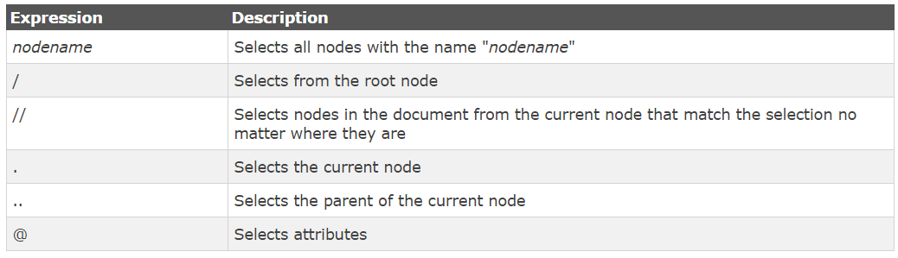
XPATH SYNTAX
XPath expression generally defines a pattern in order to select a set of nodes
Selecting Nodes:

Slide 22
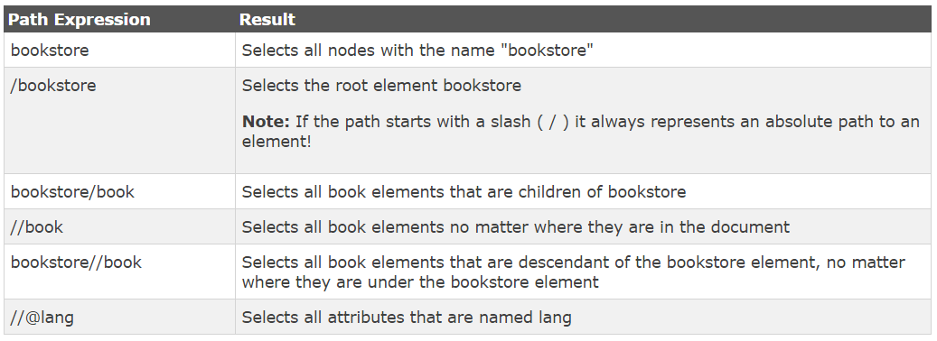
XPATH SYNTAX
<?xml version="1.0" encoding="UTF-8"?> <bookstore> <book> <title lang="en">Harry Potter</title> <price>29.99</price> </book> <book> <title lang="en">Learning XML</title> <price>39.95</price> </book> </bookstore>

Slide 23
XPATH SYNTAX
Predicates:
Predicates are used to find a specific node or a node that contains a specific value.
Predicates are always embedded in square brackets.

Slide 24
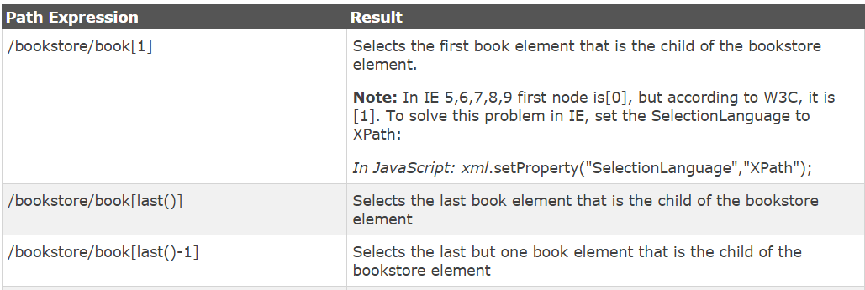
XPATH SYNTAX
<?xml version="1.0" encoding="UTF-8"?> <bookstore> <book> <title lang="en">Harry Potter</title> <price>29.99</price> </book> <book> <title lang="en">Learning XML</title> <price>39.95</price> </book> </bookstore>
Css: bookstore book:nth-child(1)
Css: bookstore book:last-child

Slide 25
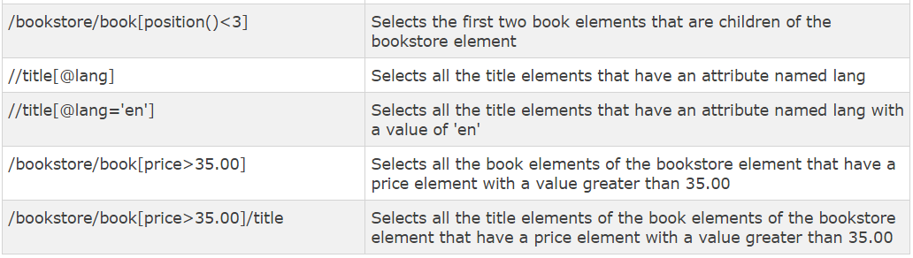
XPATH SYNTAX
<?xml version="1.0" encoding="UTF-8"?> <bookstore> <book> <title lang="en">Harry Potter</title> <price>29.99</price> </book> <book> <title lang="en">Learning XML</title> <price>39.95</price> </book> </bookstore>

Slide 26
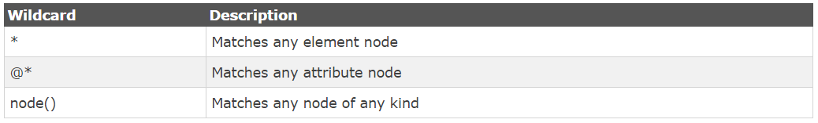
XPATH SYNTAX
Selecting Unknown Nodes:
wildcards can be used to select unknown XML elements

Slide 27
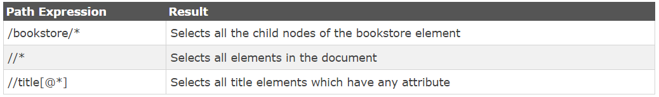
XPATH SYNTAX
<?xml version="1.0" encoding="UTF-8"?> <bookstore> <book> <title lang="en">Harry Potter</title> <price>29.99</price> </book> <book> <title lang="en">Learning XML</title> <price>39.95</price> </book> </bookstore>

Slide 28
XPATH ABSOLUTE PATH
An absolute location path starts at the root node of the document.
It consists of a slash mark (/) optionally followed by a relative location path.
The slash mark (/) selects the root node of the document.
<?xml version="1.0" encoding="UTF-8"?> <training>
<room> <title lang="en">Old Trafford</title> <table>25</table> <computer>5</computer> </room> </ training>
=> Xpath = /training/room - select room node within class root node.

Slide 29
XPATH RELATIVE PATH
Sequence of child element separated by "/"
<?xml version="1.0" encoding="UTF-8"?> <training>
<room> <title lang="en">Old Trafford</title> <table>25</table> <computer>5</computer> </room> </ training>
Xpath = //room/title - select title node relative with room node.

Slide 30
Advance Level
Notes:
Blue version _ LIKE THIS ONE THE MOST

Slide 31
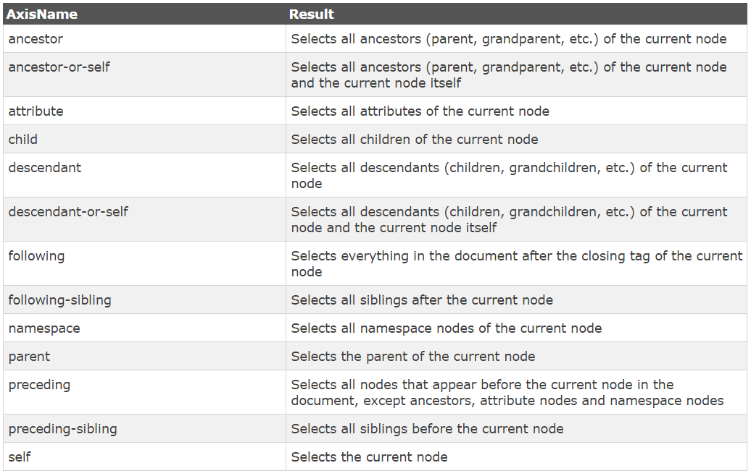
XPATH AXES
An axis defines a node-set relative to the current node.

Slide 32
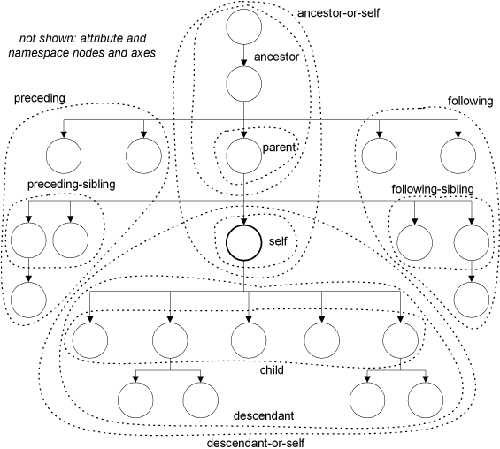
XPATH AXES

Slide 33
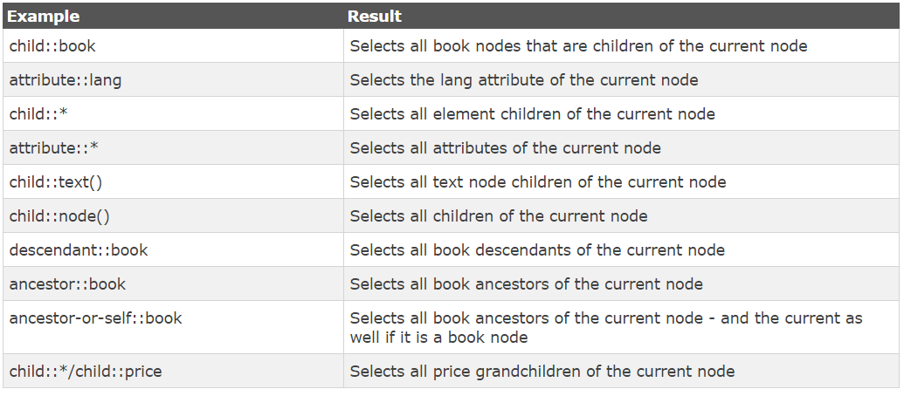
XPATH AXES
<?xml version="1.0" encoding="UTF-8"?> <bookstore> <book> <title lang="en">Harry Potter</title> <price>29.99</price> </book> <book> <title lang="en">Learning XML</title> <price>39.95</price> </book> </bookstore>
Notes:
$x('//div[@id="fkbx"]/child::div')
$x('//div[@id="fkbx"]/attribute::style')
$x('//div[@id="fkbx"]//attribute::aria-label')
$x('//div[@id="lga"]//child::text()')
$x('//div[@id="fkbx"]/descendant::div')
$x('//div[@id="fkbx"]/ancestor::form')
$x('//div[@id="fkbx"]/ancestor-or-self::div')
$x('//form[@id="f"]/child::*')
$x('//form[@id="f"]/child::*/child::input')
$x('//form[@id="f"]/child::*/child::div')
$x('//div[@id="fkbx-text"]/following::*')
$x('//div[@id="fkbx-text"]/following-sibling::*')
$x('//div[@id="fkbx"]/preceding-sibling::*')
$x('//div[@id="fkbx"]/preceding::*')

Slide 34
XPATH AXES
XML: <bookstore> <book> <title lang="en">Harry Potter</title> </book> </bookstore>
DOM: element node (name=" bookstore")
text node (value="\n ")
element node (name=" book")
text node (value="\n ")
element node (name="title")
text node (value="Harry Potter")

Slide 35
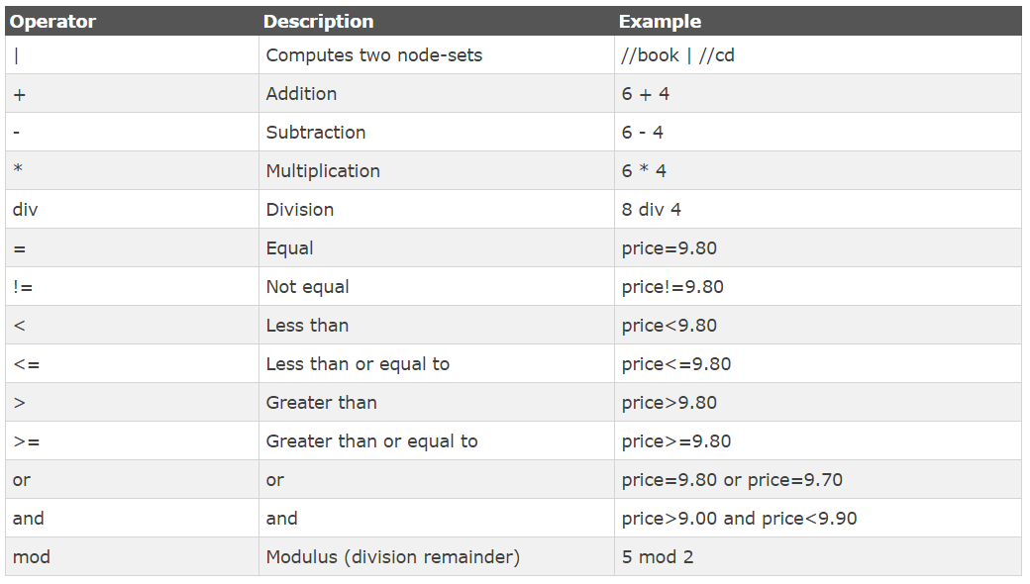
XPATH OPERATORS

Slide 36
XPATH OPERATORS
<?xml version="1.0" encoding="UTF-8"?> <bookstore> <book> <title lang="en">Harry Potter</title> <price>29.99</price> </book> <book> <title lang="en">Learning XML</title> <price>39.95</price> </book> </bookstore>
//book/title | //book/price
//book[position()>1]
//book[title=“Harry Potter”]

Slide 37
XPATH FUNCTIONS
Accessor (skip)
Error and Trace(skip)
Numeric
String
AnyURI (skip)
Boolean
Duration/Date/Time (skip)
Qname (skip)
Node (skip)
Sequence (skip)
Context (skip)

Slide 38
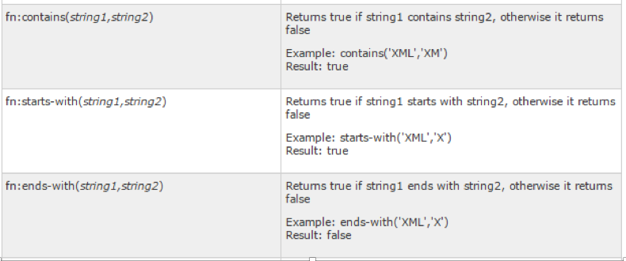
XPATH FUNCTIONS - STRING
Browsers currently supports XPath 1.0

Slide 39
XPATH USEFUL EXPRESSIONS
//div[@title=‘main']: Find <div> tag that have an attribute “title” with value “main”.
//*[contains(@title,'Nick Name')]: Find any tag that have attribute “title” with contains value “Nick Name”.
//input[contains(text(),'Nick Name')]
//h2[normalize-space(.)=’Search All']
//input[contains(.,'Nick Name')] : Find <input> tag that have text inside with value contains “Nick Name”.
//*[starts-with(@title,'Nick Name')]: Find any tag that have attribute “title” with value starts-with “Nick Name”.
//*[@id='btnCheck' and @value='boxNickName']:Find any tag that have attribute “id” with value “btnCheck” and attribute “value” with value “boxNickName”
string(//div[@class="logo-subtext"]): Get text Value of text node that is child of <div> tag. Selenium or another tool implement the method to get this value.

Slide 40
Summary

Slide 41
Best Practices

Slide 42

Best Practices
A locator order: id > class > name > css > xpath
<form name="loginForm">
<label for="username">UserName: </label>
<input type="text" id="username" /><br/>
<label for="password">Password: </label>
<input type="password" id="password" /><br/>
<input name="login" type="submit" value="Login" />
</form>
=>
By.xpath(“//div[@id=username’]”) By.css(“#username”)
By.id(“username”)

Slide 43
Best Practices
A locator should be as small as possible
<form name="loginForm">
<label for="username">UserName: </label>
<input type="text" id="username" /><br/>
<label for="password">Password: </label>
<input type="password" id="password" /><br/>
<input name="login" type="submit" value="Login" />
</form>
=>
By.xpath(“//div[@id=username’]”) By.xpath(“//*[@id=username’]”)
By.css(“form label input:nth-child(1)”)
By.css(“#username”)
By.id(“username”)

Slide 44
Best Practices
A locator should not get effected by changes from another
<form class="loginForm">
<label class="username_lbl">UserName: </label>
<input class="username_text"/><br/>
<label class ="password_lbl">Password: </label>
<input class="password_text "/><br/>
<input class ="submit" value="Login" />
</form>
=> If the element has no html id, must find other way to locate the element
By.xpath(“//form/label/input[1]”)
By.css(“form>label>input:nth-child(1)”)
What’s problem here?

Slide 45
Best Practices
A locator should not get effected by changes from another
<form class="loginForm">
<label class="username_lbl">UserName: </label>
<input class="username_text"/><br/>
<label class ="password_lbl">Password: </label>
<input class="password_text "/><br/>
<input class ="submit" value="Login" />
</form>
<div class=”username_grp">
</div>
=>
By.xpath(“//form/label/input[1]”)
By.css(“form>label>input:nth-child(1)”)
By.css(“label.username_lbl input.username_text”)

Slide 46
Best Practices
A locator should be valid when properties changed
<form name="loginForm">
<label for="username">UserName: </label>
<input type="text" id="username" value=“empty” lang=“def-Eng” size=“50”/><br/>
<label for="password">Password: </label>
<input class="password resize new" id="password" /><br/>
<input name="login" type="submit" value="Login" />
</form>
=>
By.xpath(“//input[@id=username’][@size=“50”][@ value=“empty”]”)
By.css(“input.password.resize.new”)
What’s problem here?

Slide 47
Best Practices
A locator should be valid when properties changed
<form name="loginForm">
<label for="username">UserName: </label>
<input type="text" id="username" value=“empty” lang=“def-Eng” size=“80”/><br/>
<label for="password">Password: </label>
<input class="password resize new1" id="password" /><br/>
<input name="login" type="submit" value="Login" />
</form>
=>
By.xpath(“//input[@id=username’][@size=“50”][@ value=“empty”]”)
By.css(“input.password.resize.new”)
By.xpath(“//input[@id=username’]”) or By.css(“input#username”)
By.css(“input.password”)

Slide 48
REFERENCES
http://www.w3.org/TR/xpath/#node-tests
http://www.tutorialspoint.com/xpath/index.htm
https://www.w3schools.com/xml/xpath_intro.asp
https://developer.mozilla.org/en-US/docs/Web/XPath/Functions
XSLT and XPATH: A Guide to XML Transformations- James Robert Gardner

Slide 49
THANK YOU
Q & A

